Slide 1

Library Management System
Group 1
Hadush Hailu, Sanjukta Sunar, Luwam Weldetensae
Apr 12, 2024

Slide 2
Contents
Use Case Diagram
Class Model Diagram
Sequence Diagram
Validation Rules
Conclusion with SCI Knowledge

Slide 3
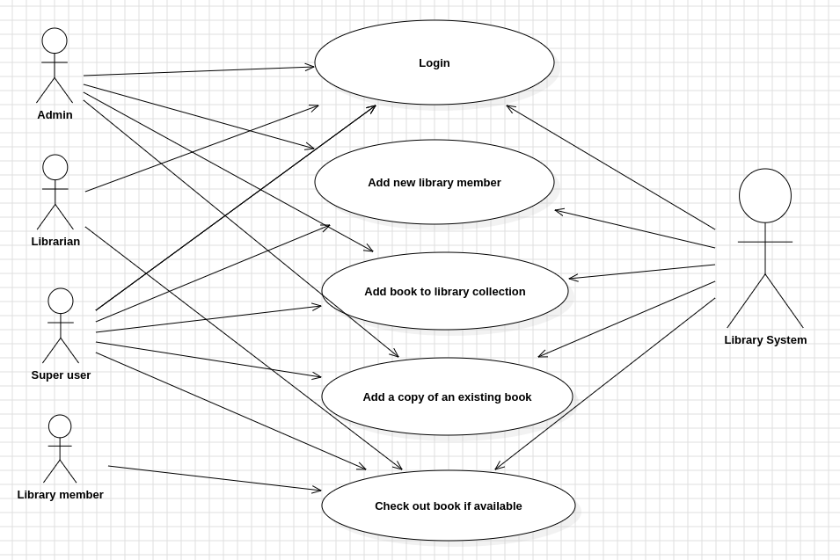
Use Case Diagram

Slide 4
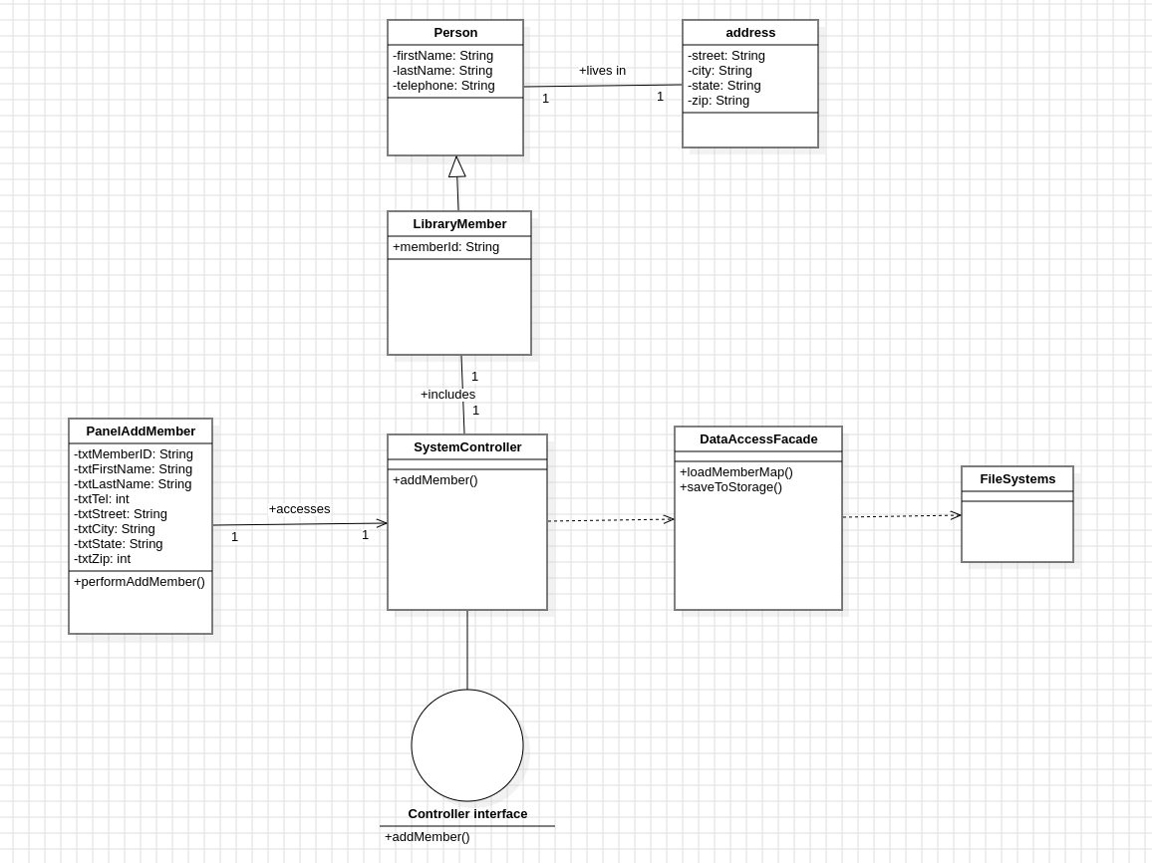
Class Diagram

Slide 5
Sequence Diagram
The following use case diagrams are attached as PDF format:
Checkout Book Use case
Add a copy of an existing book.
Add a new member.

Slide 6
Validation rules
Validation rule is attached as PDF format as 5_validation_rules.pdf

Slide 7
Validation rules
Validation rule is attached as PDF format as:
5_validation_rules.pdf

Slide 8
SCI Knowledge
We would like to relate our project to some of the fundamentals we have been taught, so that we can best progress through life:
Integration: To be a person of integrity, both personally and professionally, all the elements of our life must be integrated. And In Our Library system all the business layers, controllers, data access and UI layers had to be integrated properly to have a fully functioning application
growth: the nature of life is to grow. We always want to be taking that upward direction in life. And our team has been working really hard by taking the upward direction to make our library system application grow in the right direction.

Slide 9
END!!

